Slide 1
Unit 4
Starting of Electric Motors

Slide 2
Effects of starting motors on power supply
Transient processes that occur in drive system are starting, braking, speed control and reversal of direction of rotation.
Starting of electric drive involves a change in its state from rest to a steady state of rotation during which motor draws very high current (many times higher than full load current).
The high current drawn has following effects:
1. Voltage drop in the supply.
2. Excessive current drawn may damage the windings of the motor.
3. Mechanical damage to the connected load through too rapid acceleration

Slide 3
Necessity of starting equipment
The effects are negligible in case of small motors but in case of higher rating motors the starting current need to be limited.
This limitation of current may be accomplished by reducing the voltage applied to the motor by means of a resistance in series with the motor or by some other suitable means as briefed below:
1. Direct-on-Line Starting or Full-Voltage Starting
2. Reduced-Voltage Starting
3. Starting by Means of Smooth Variation of Voltage or Frequency (Constant V/f method)
4. Starting of AC Commutator Motors

Slide 4
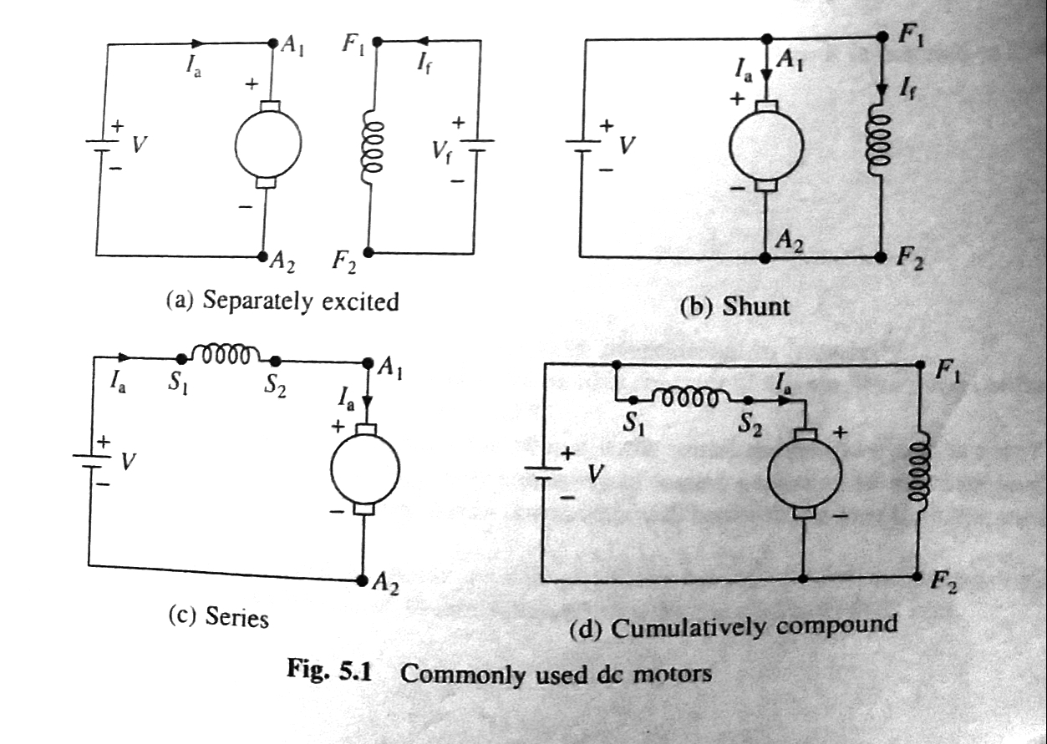
DC motors

Slide 5
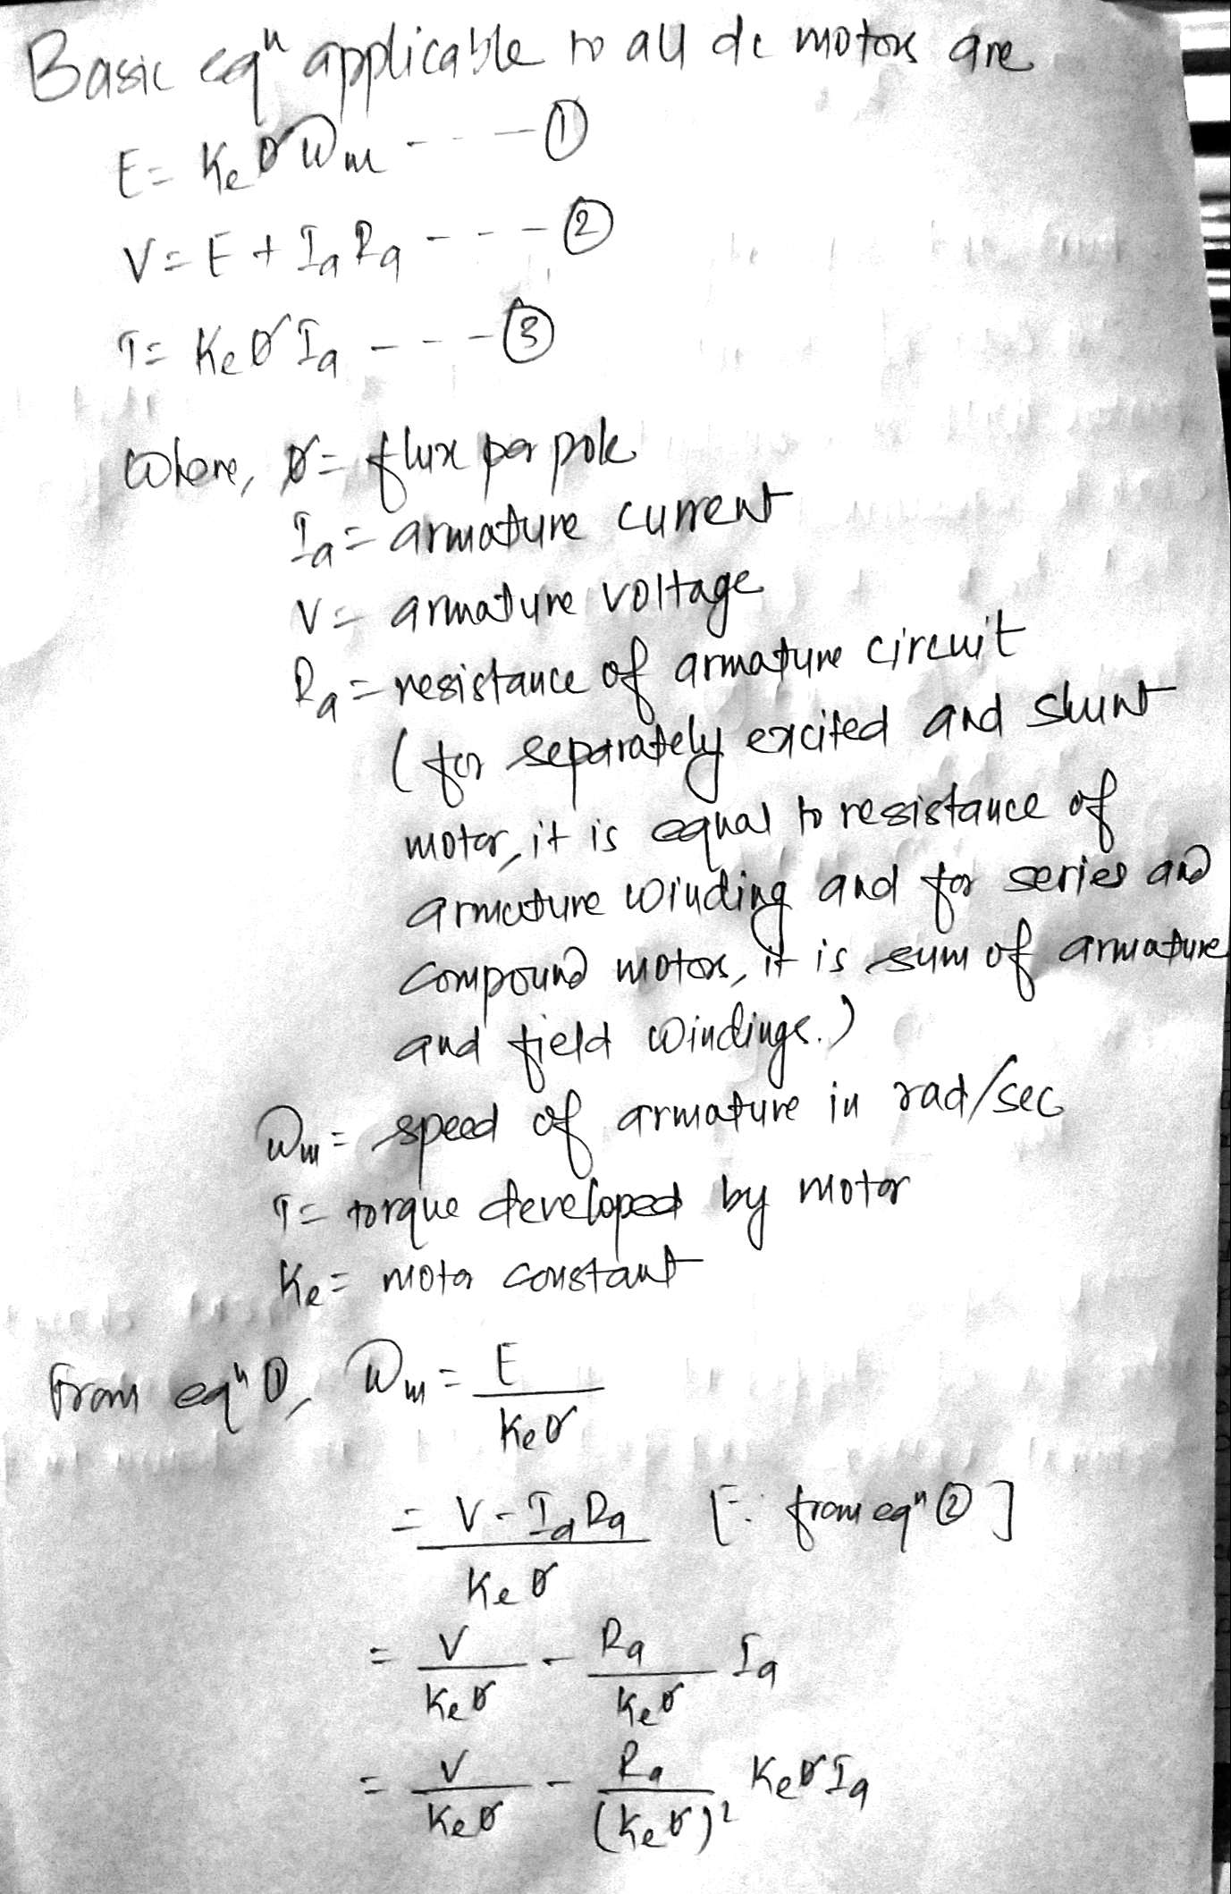

Slide 6
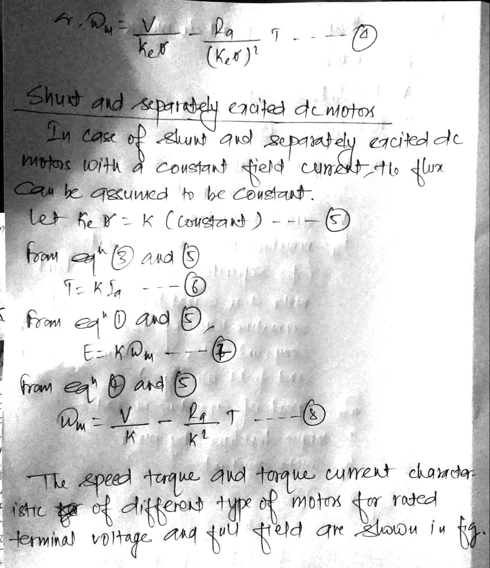

Slide 7
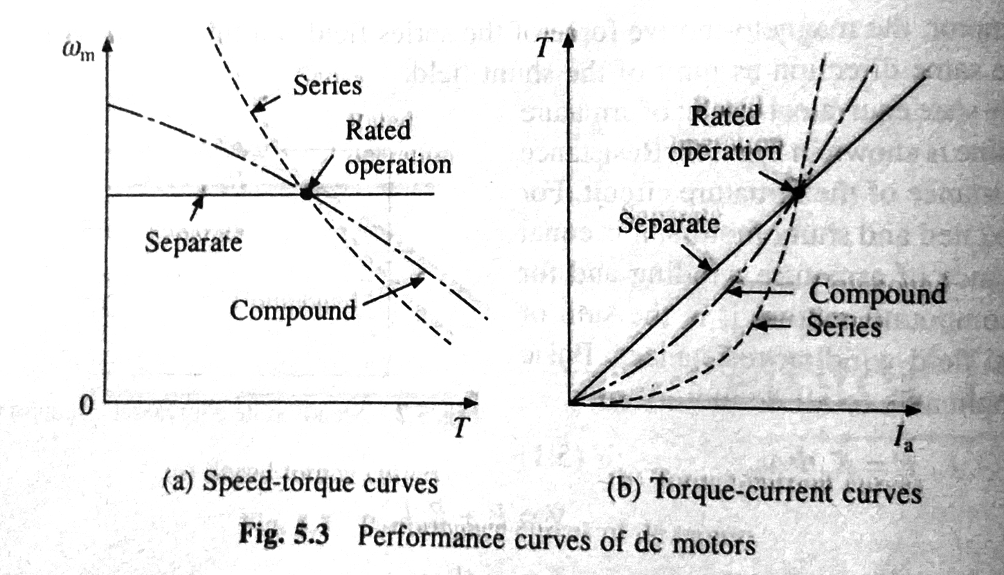

Slide 8
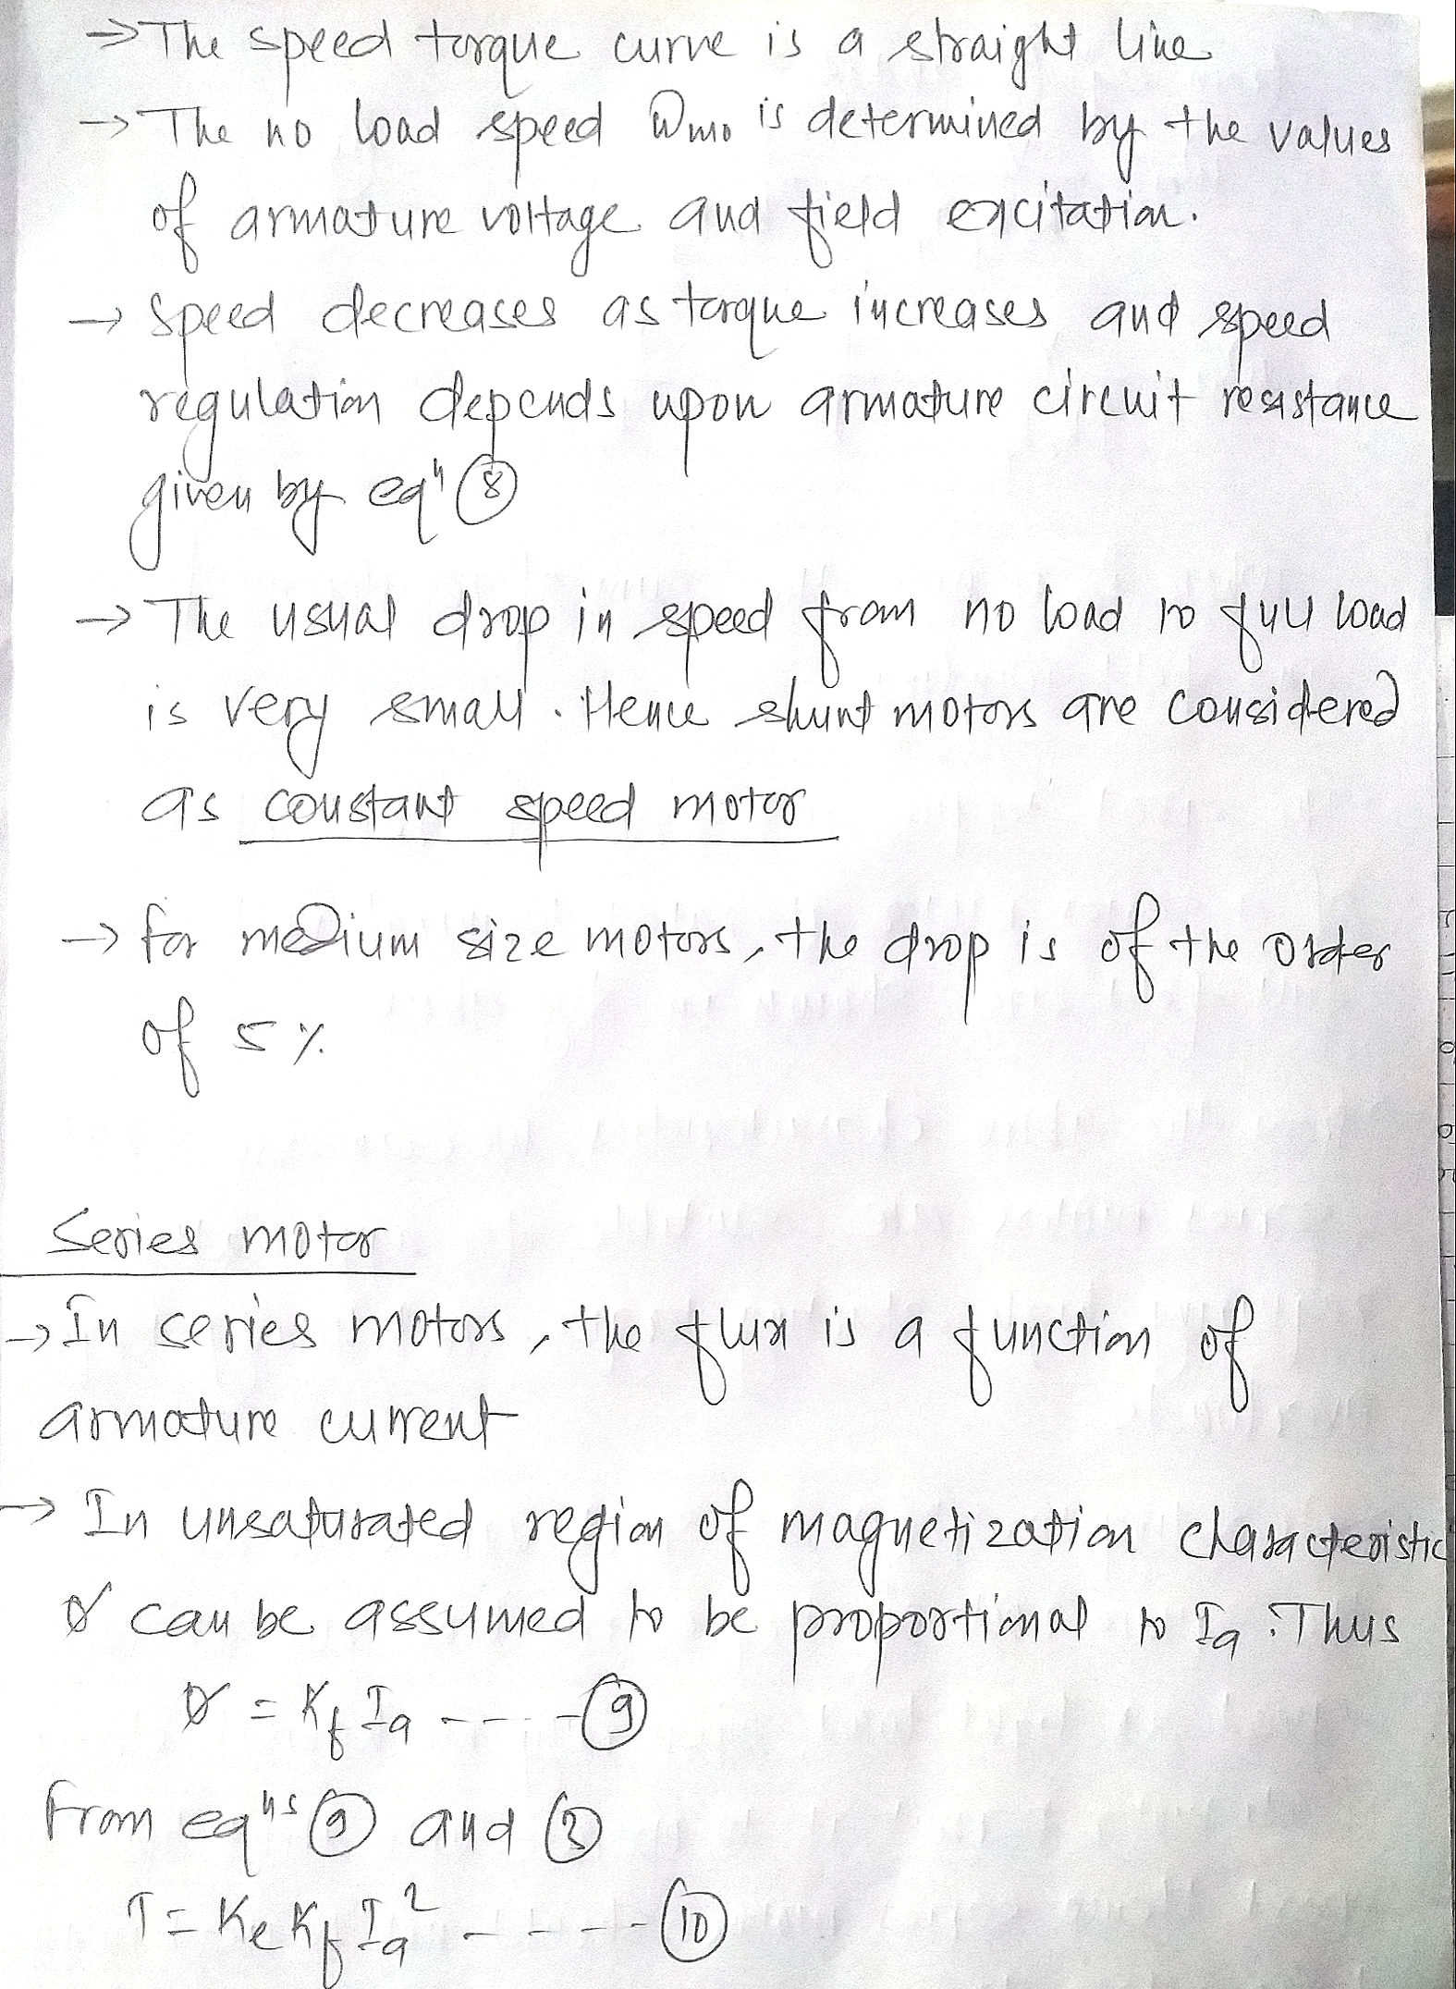

Slide 9
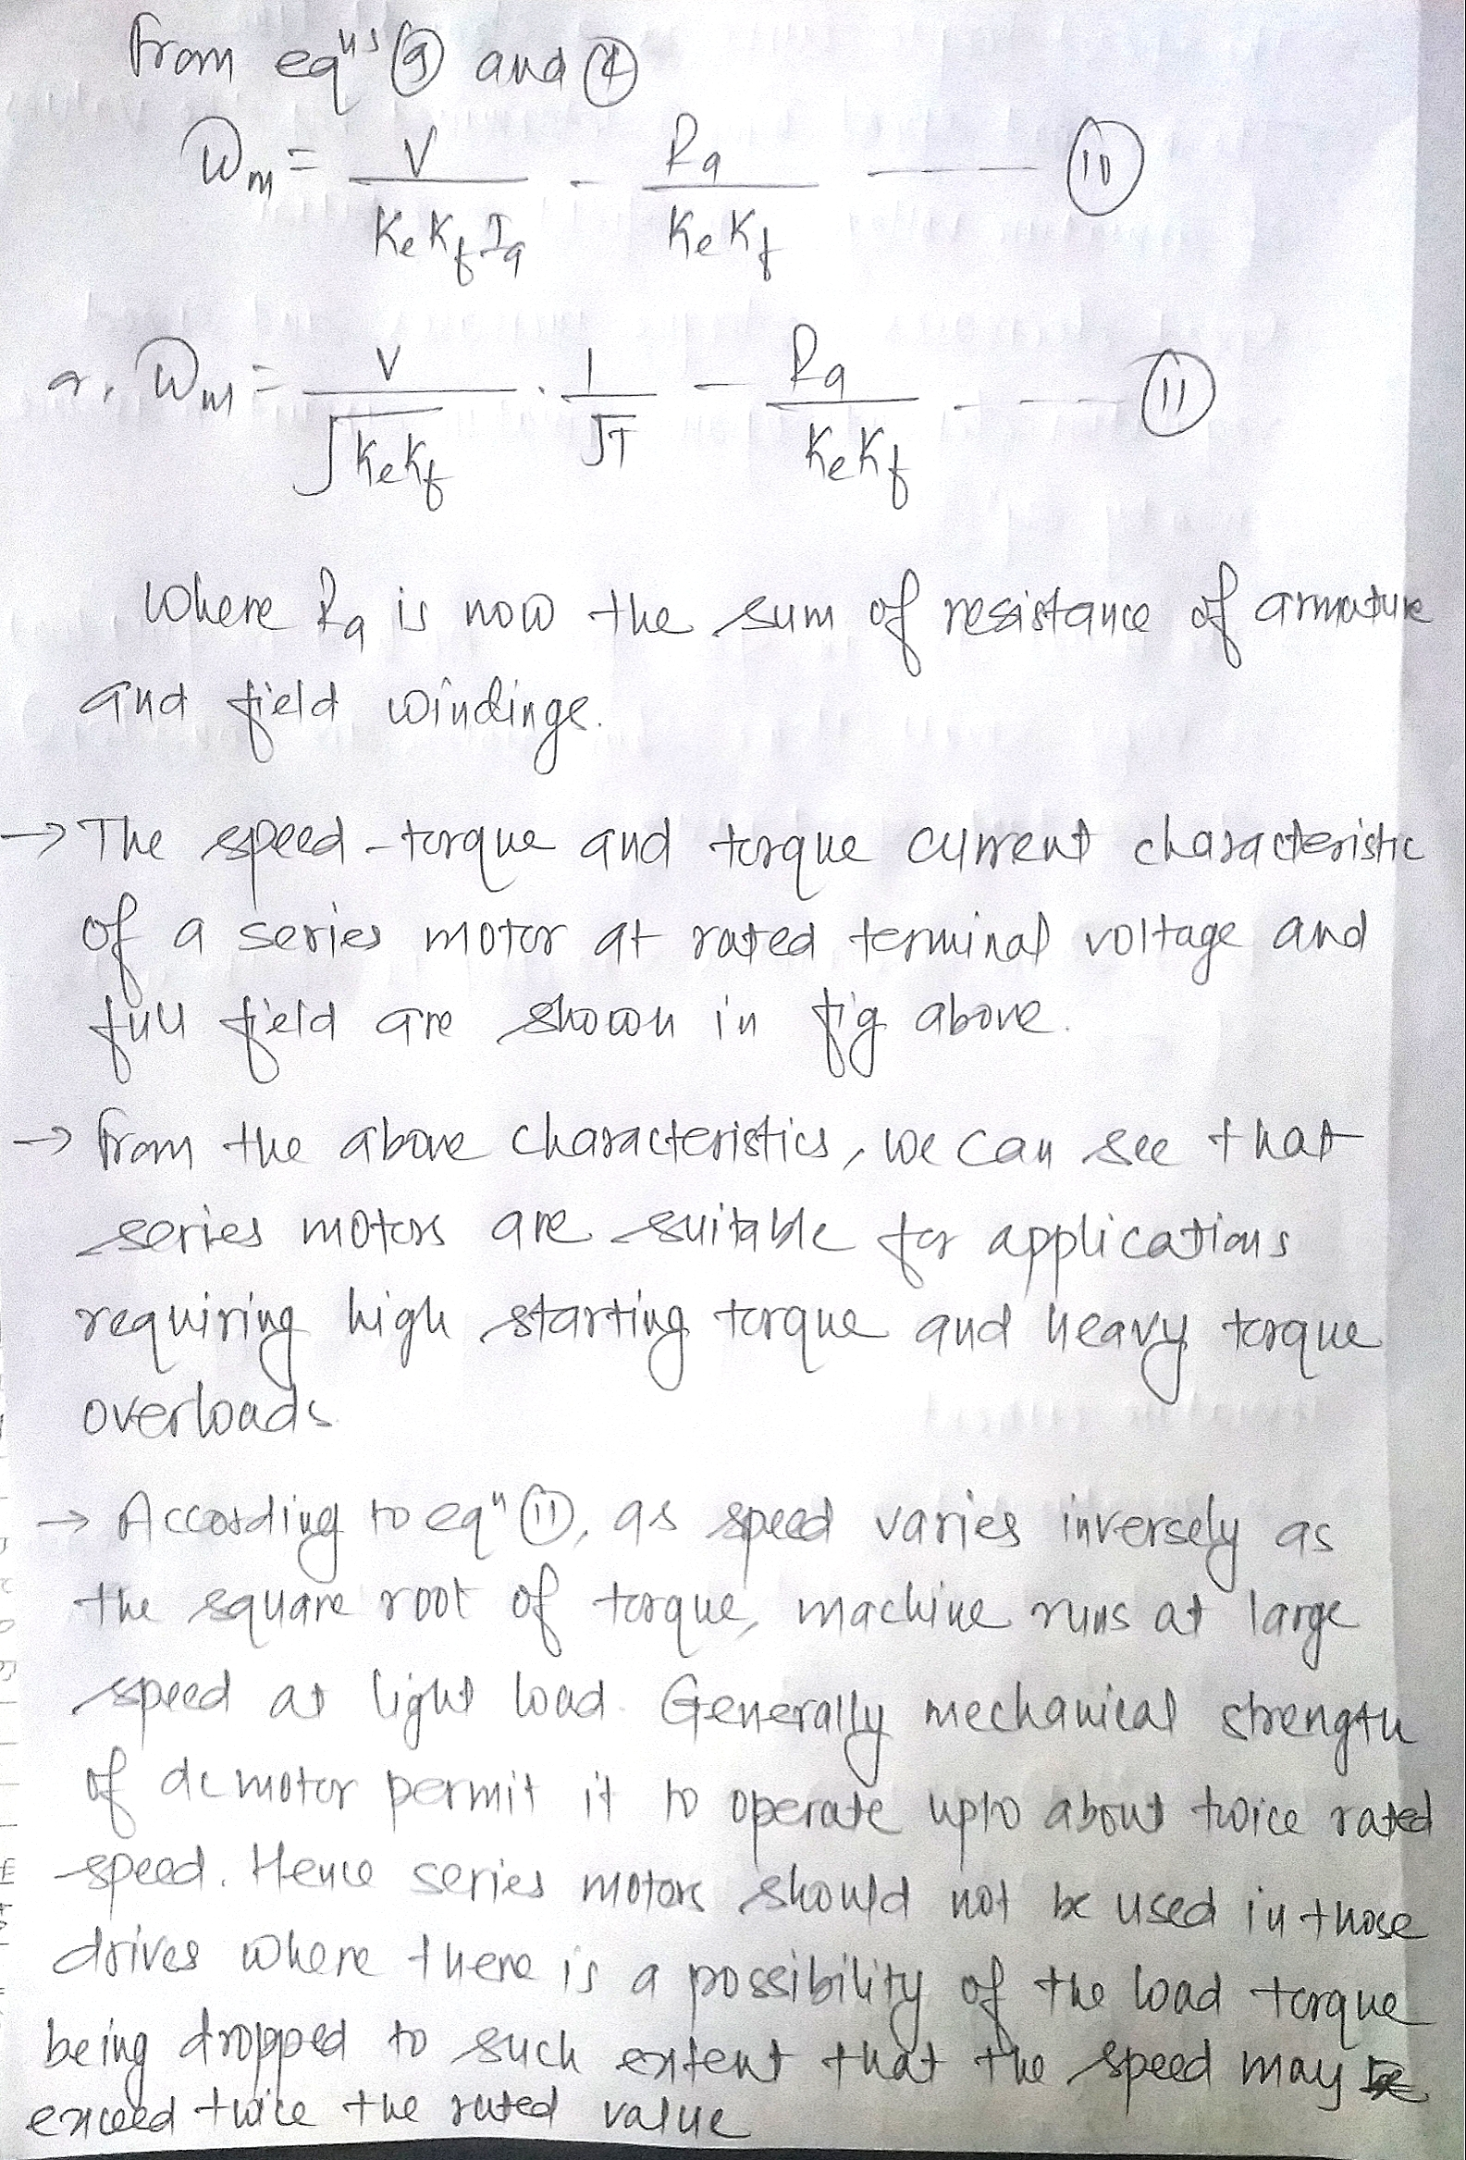

Slide 10
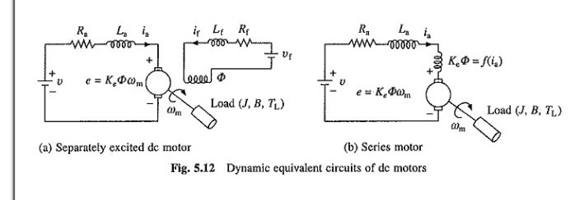
Starting dynamics of dc drives

Slide 11
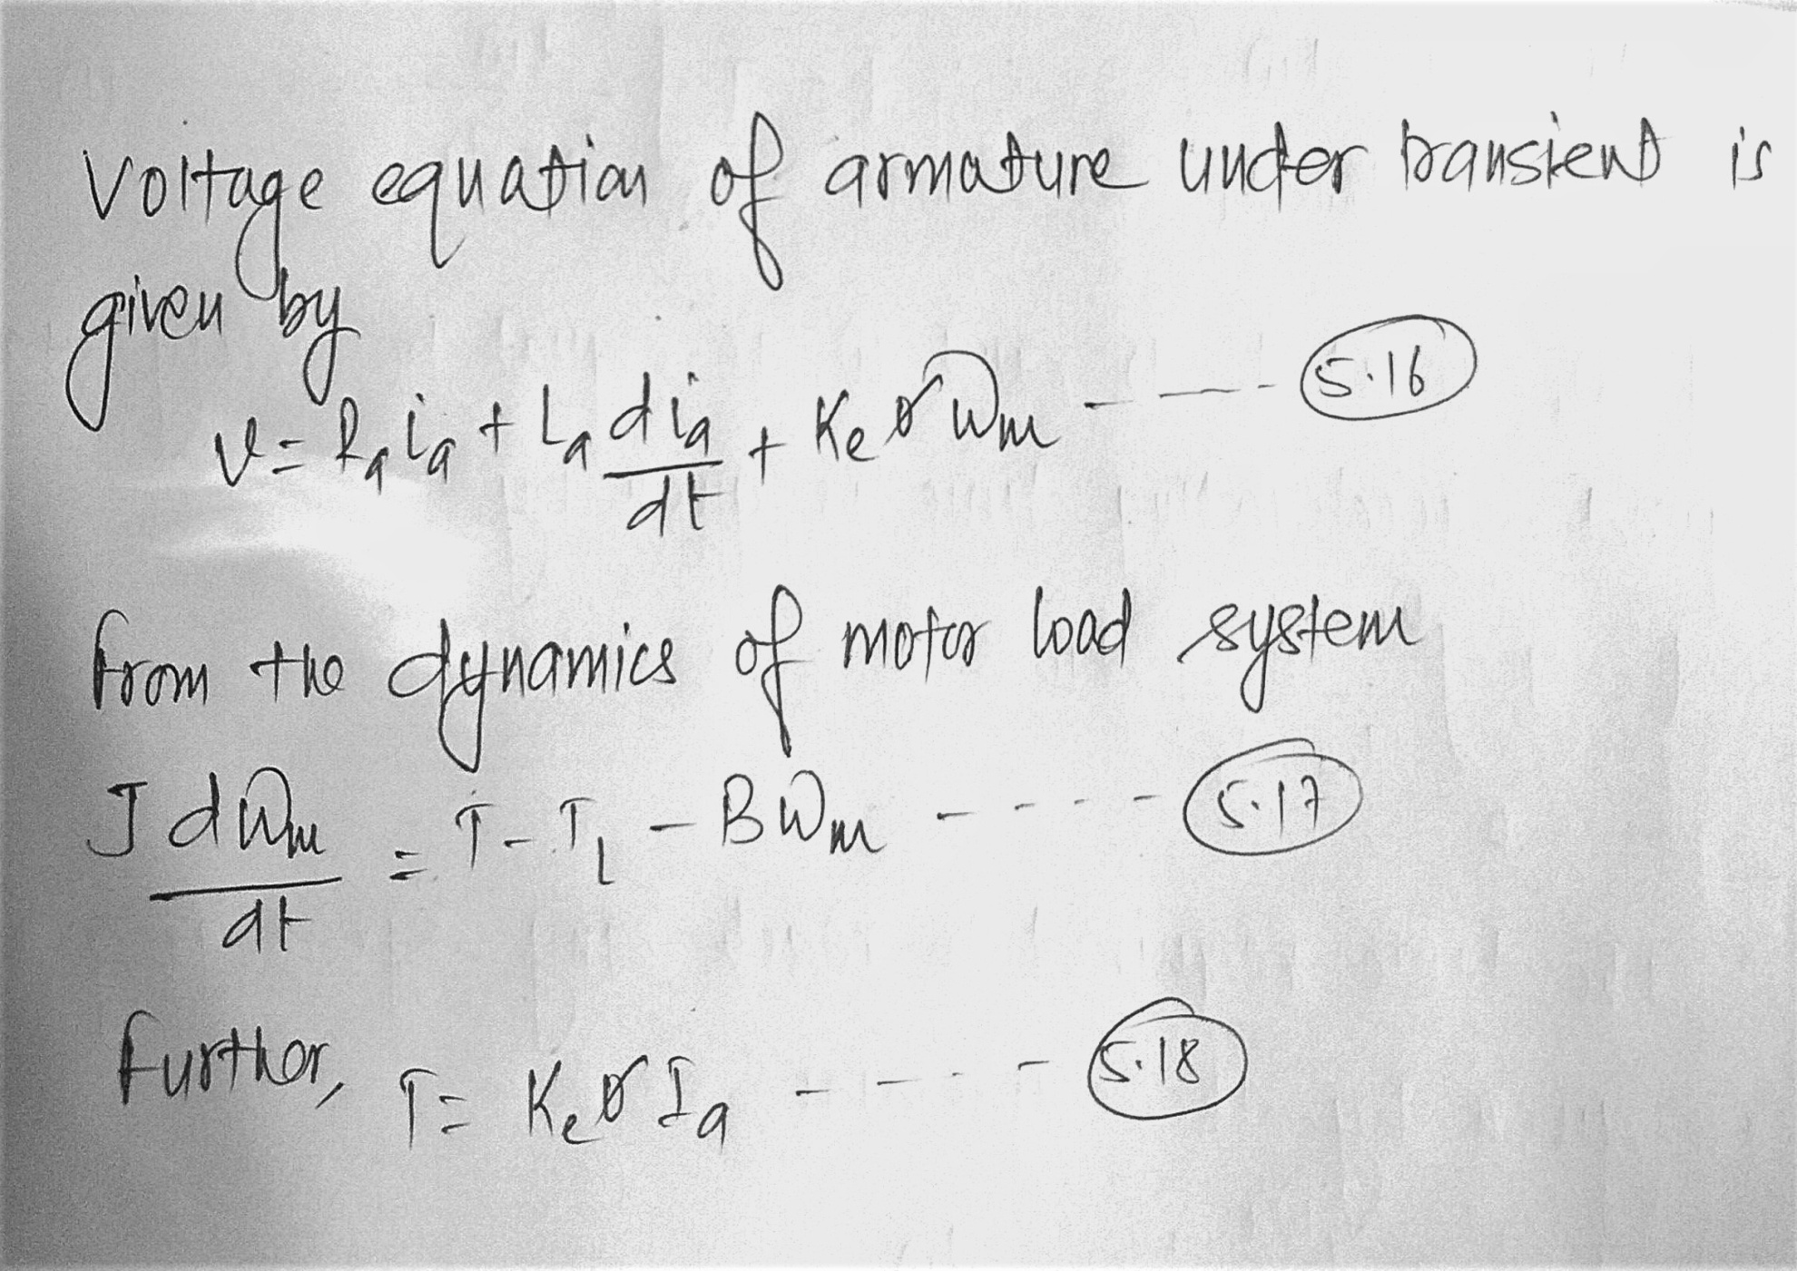

Slide 12
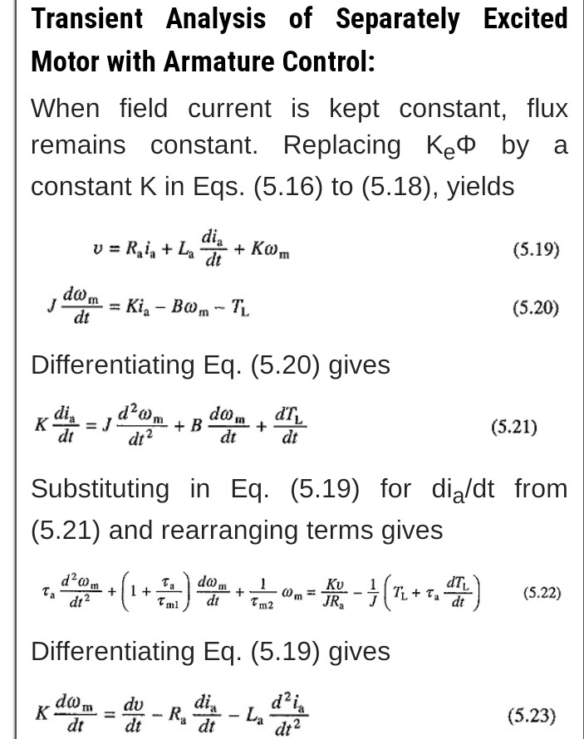

Slide 13
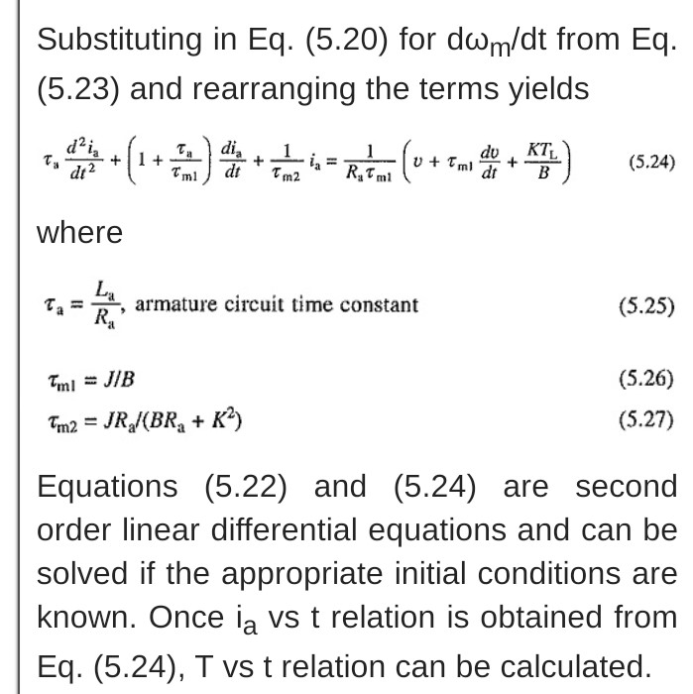

Slide 14
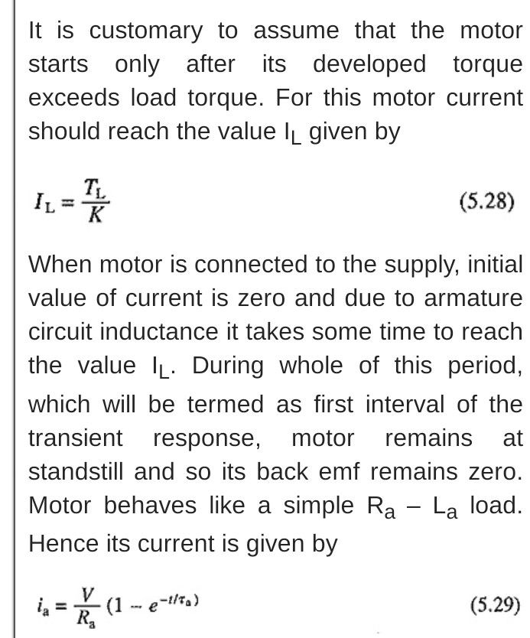

Slide 15
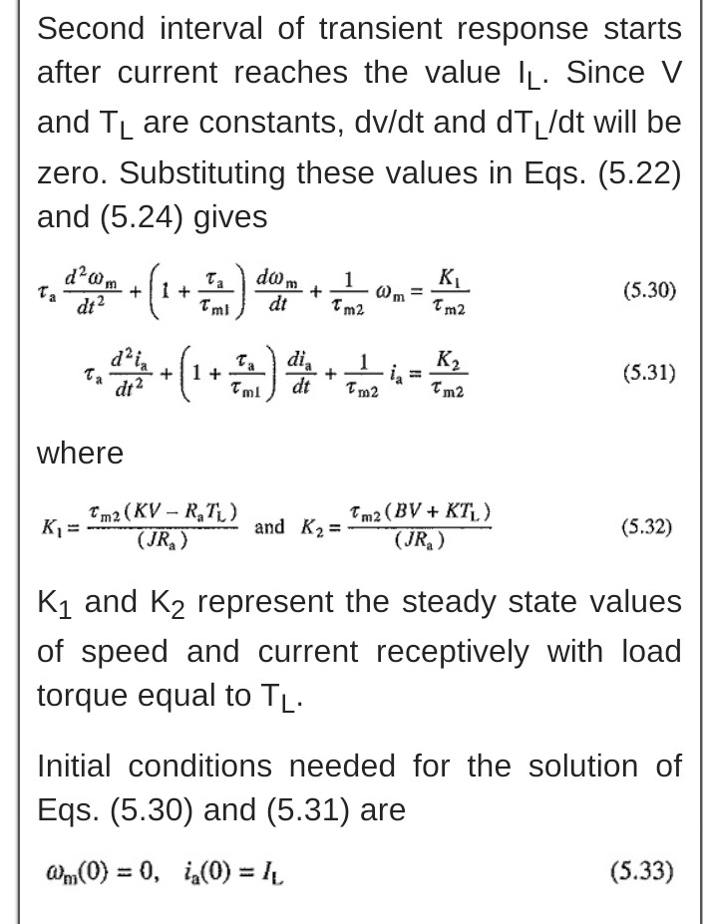

Slide 16
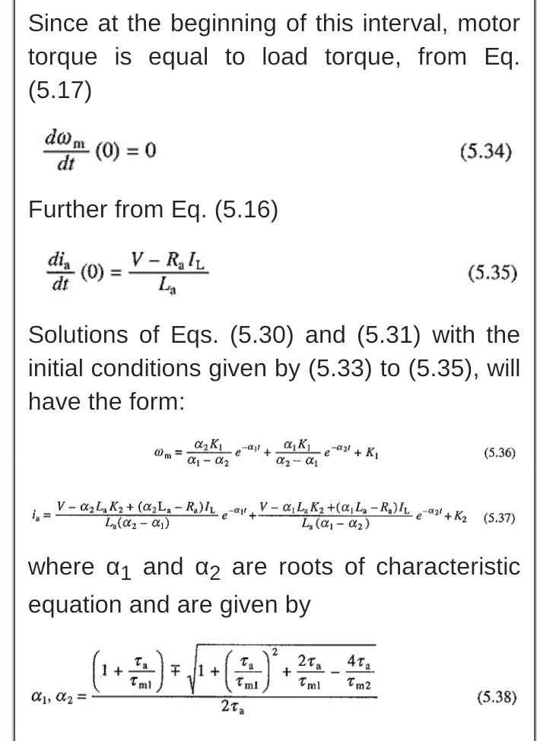

Slide 17
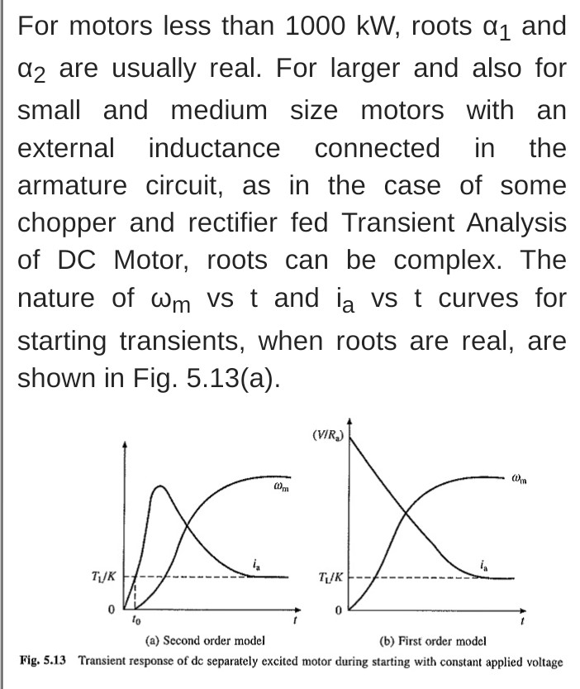

Slide 18
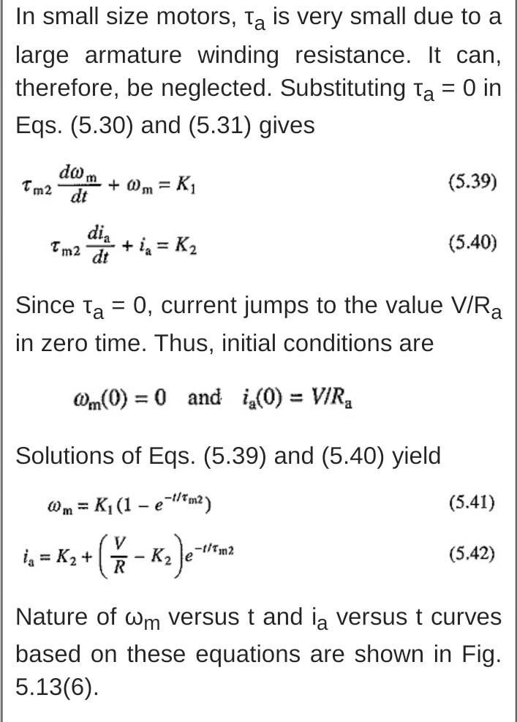

Slide 19
Starting of three phase induction motor
By using primary resistors
Auto transformer method
Star delta starter
Adding resistance in rotor circuit

Slide 20
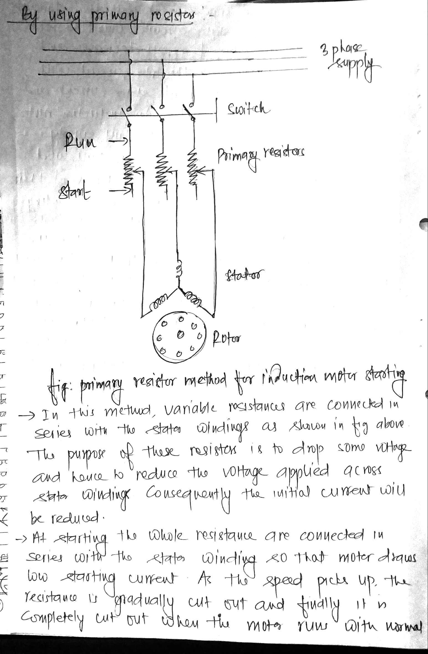

Slide 21
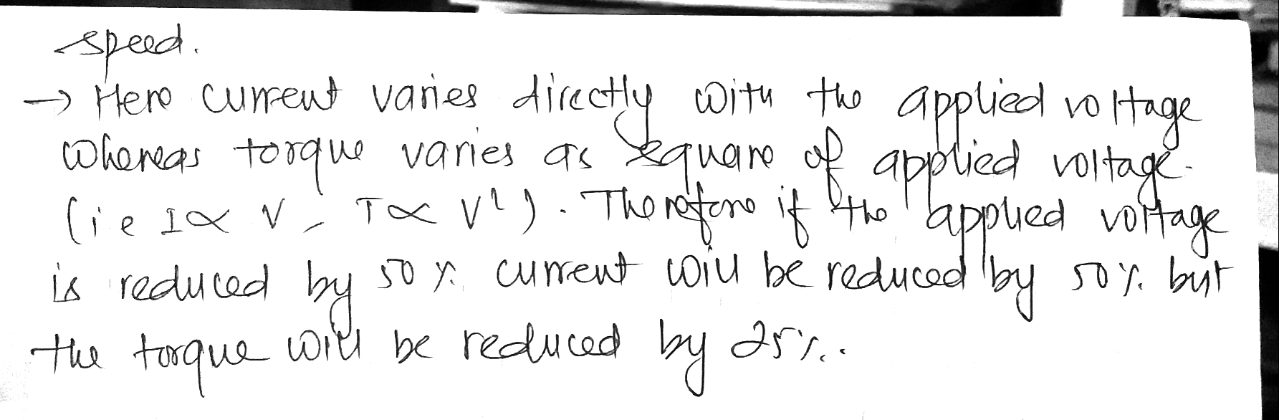

Slide 22
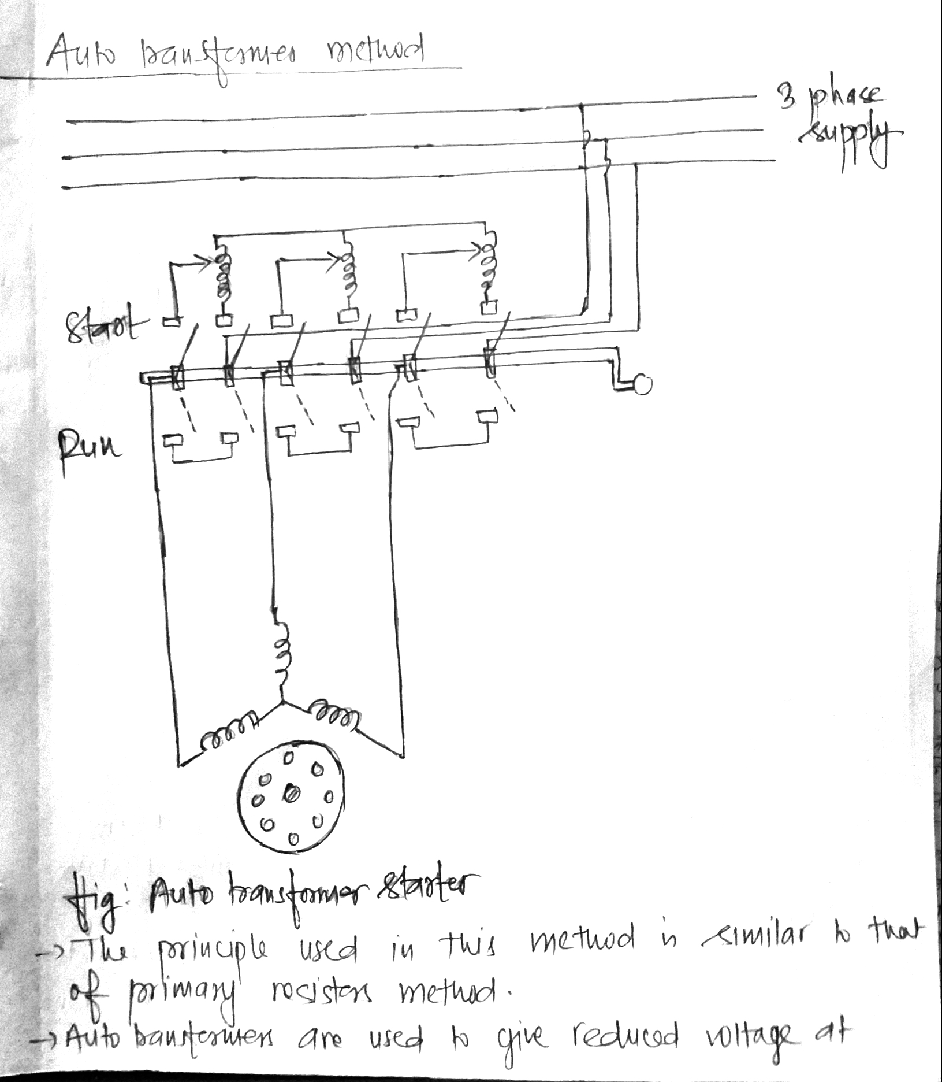

Slide 23
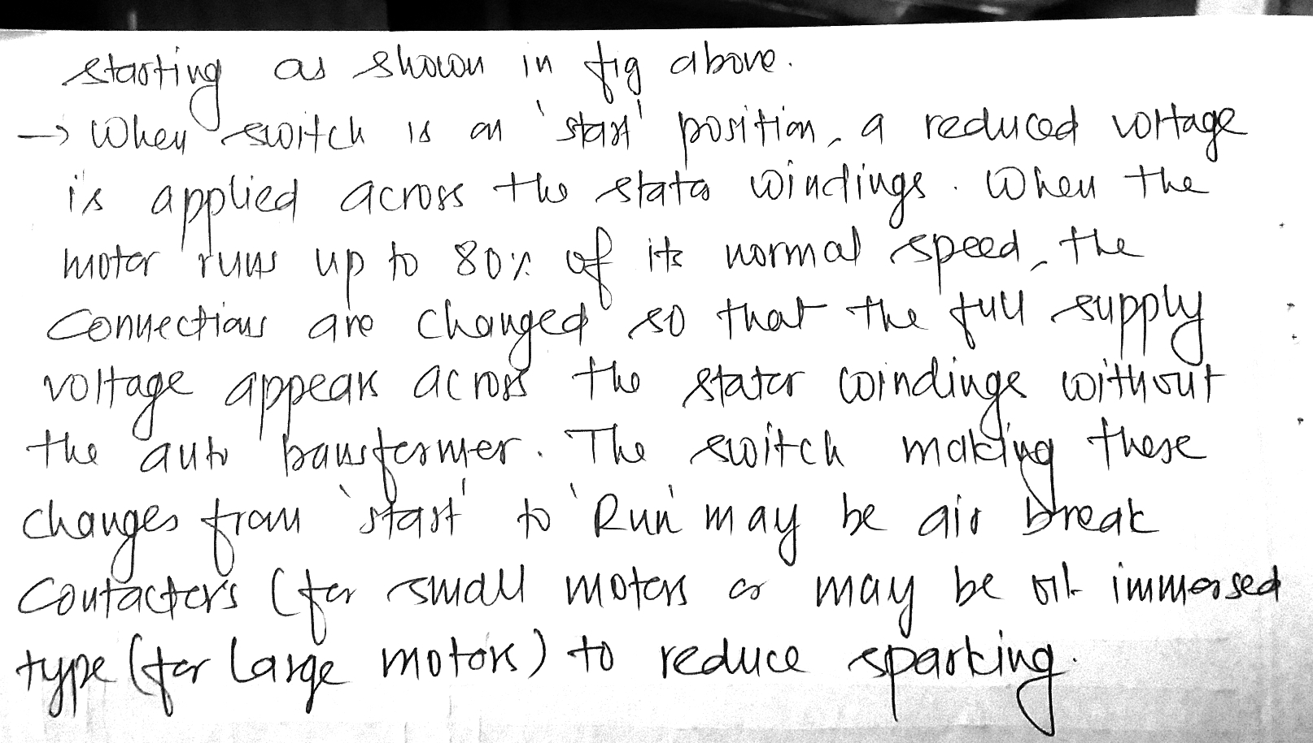

Slide 24
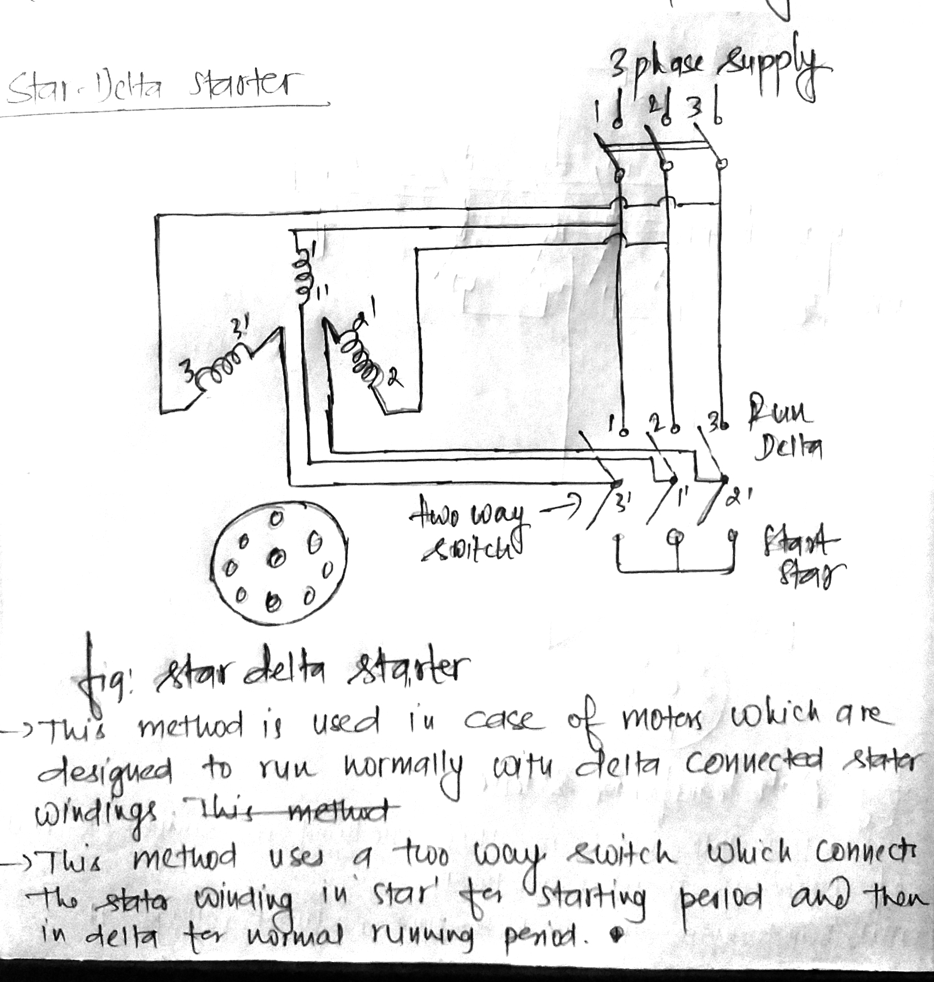

Slide 25
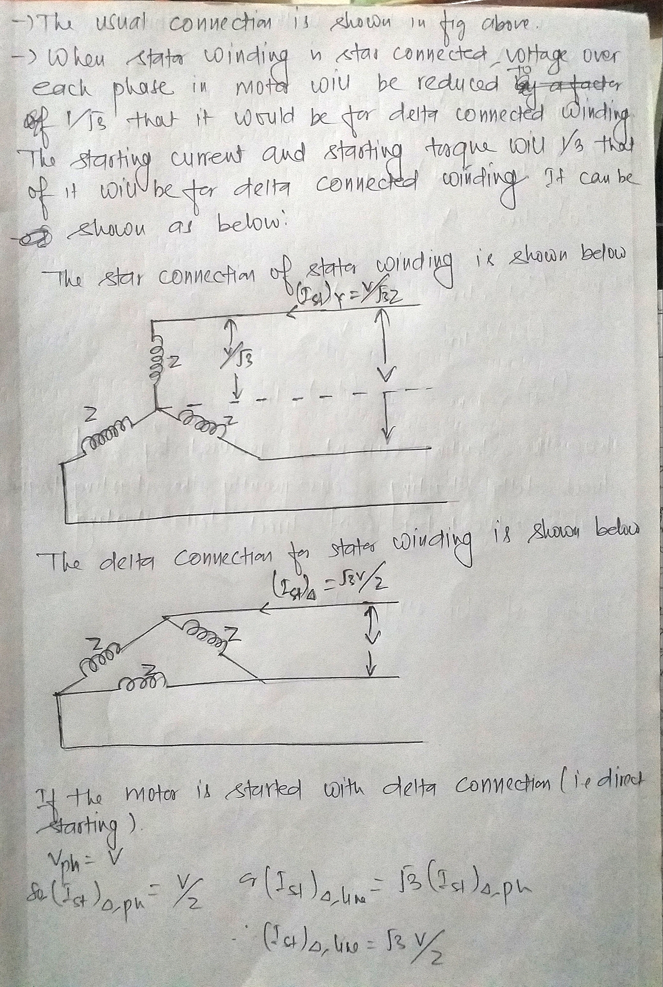

Slide 26
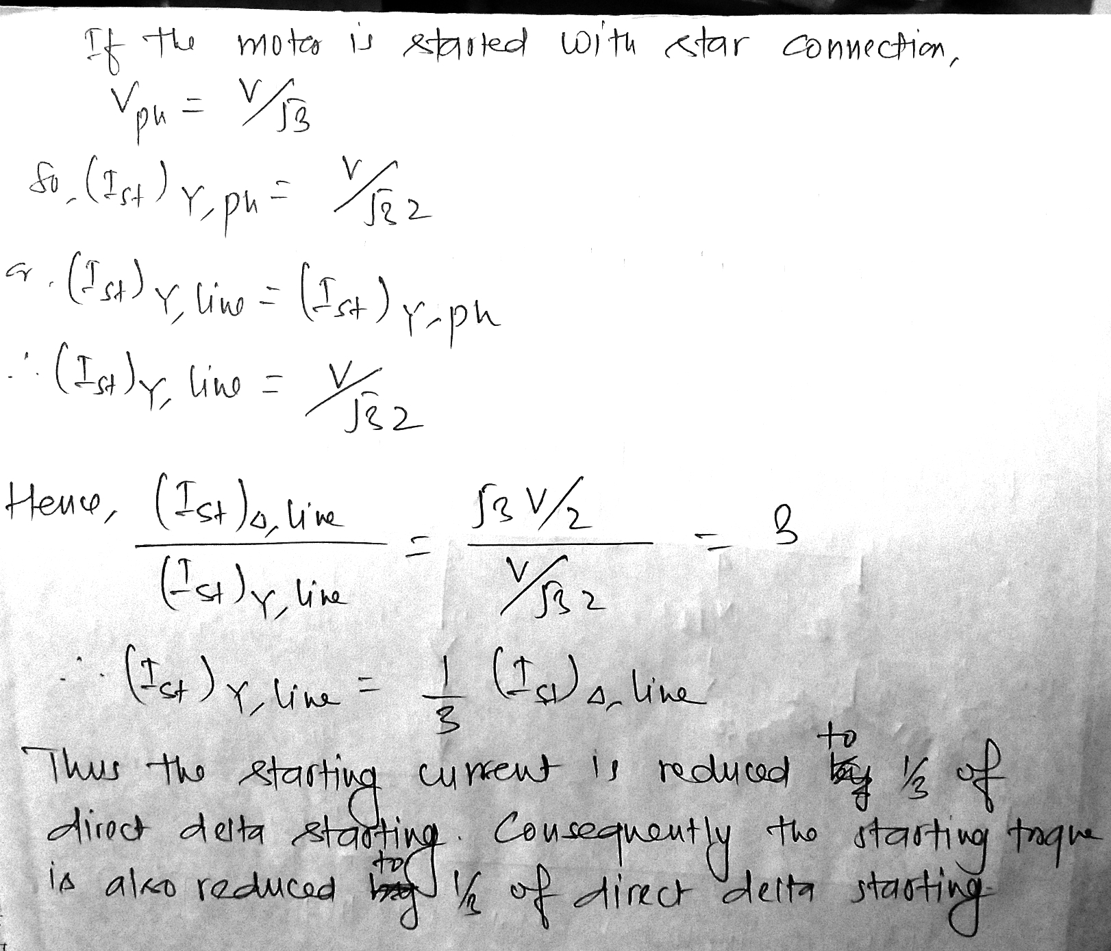

Slide 27
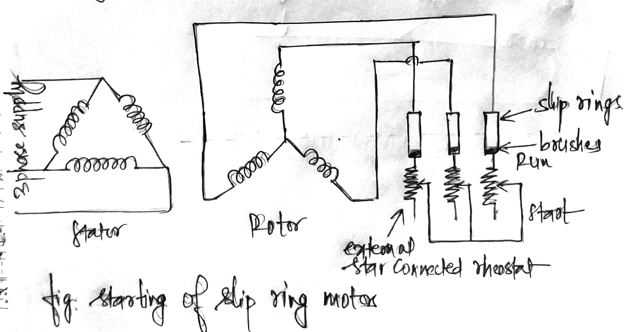
By adding resistance in rotor circuit(for slip ring motors)

Slide 28
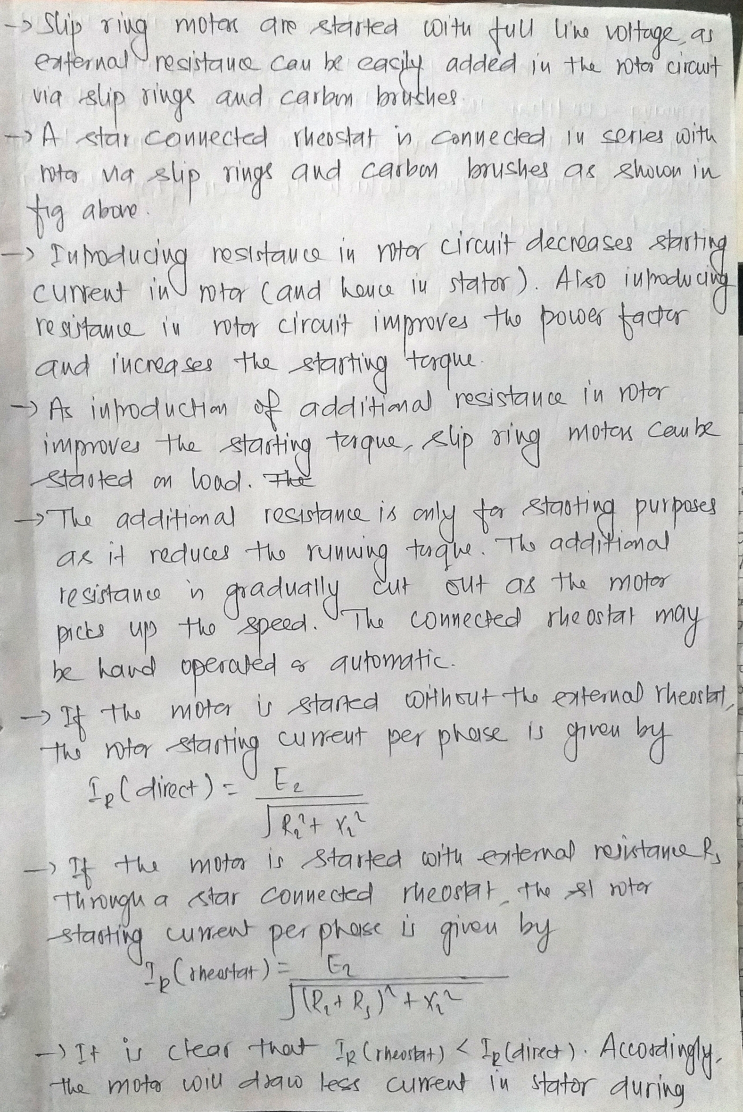

Slide 29
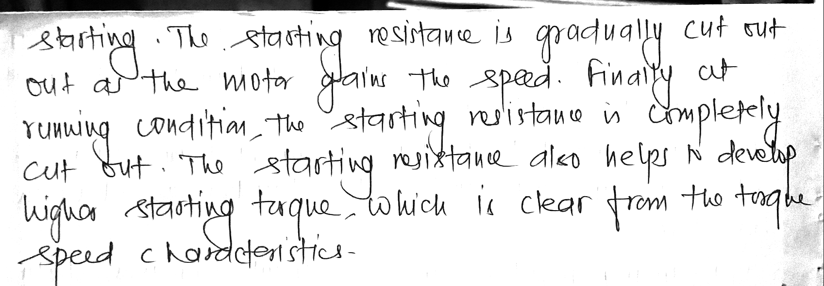

Slide 30
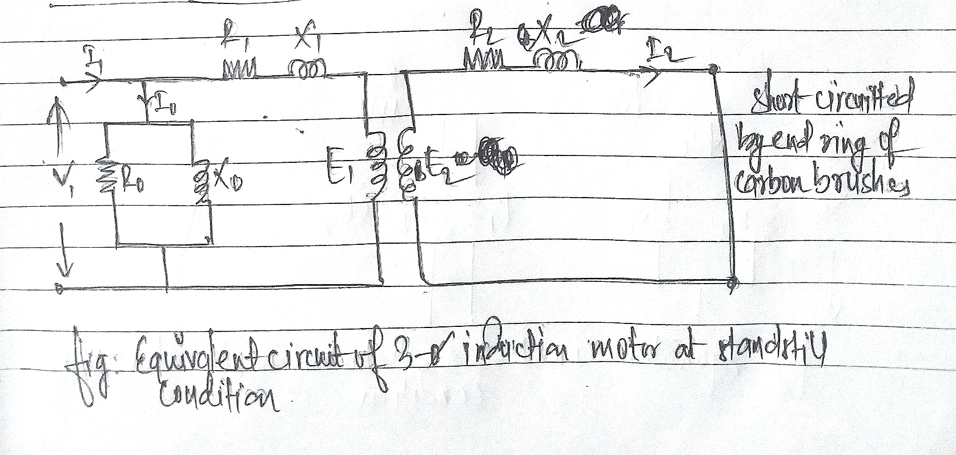
Three phase induction motor

Slide 31
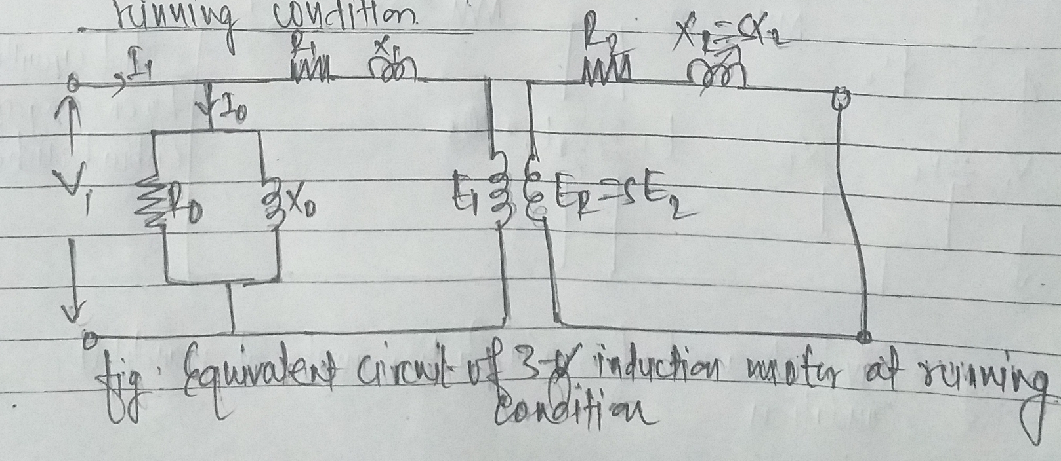

Slide 32
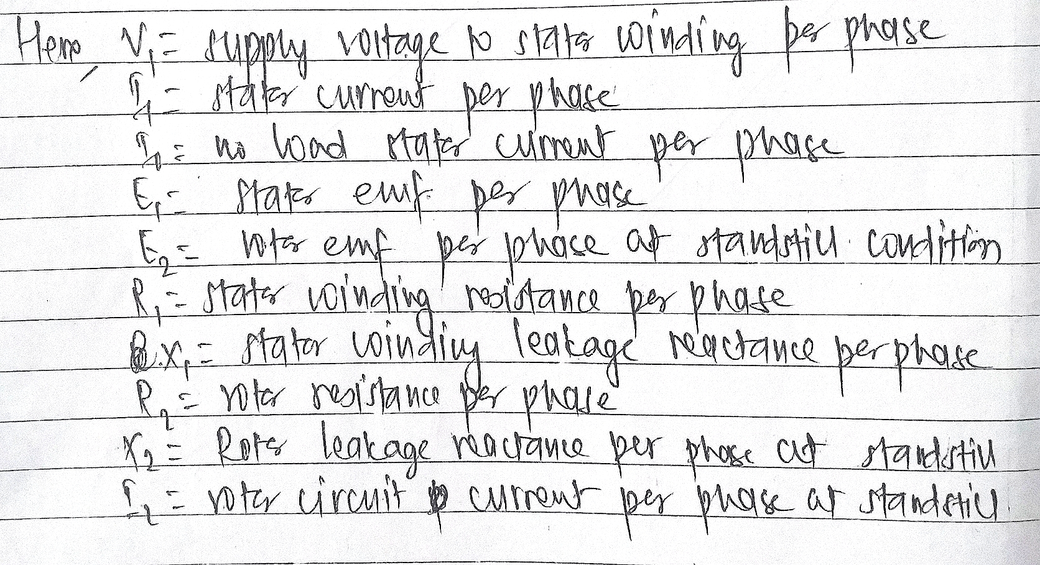

Slide 33
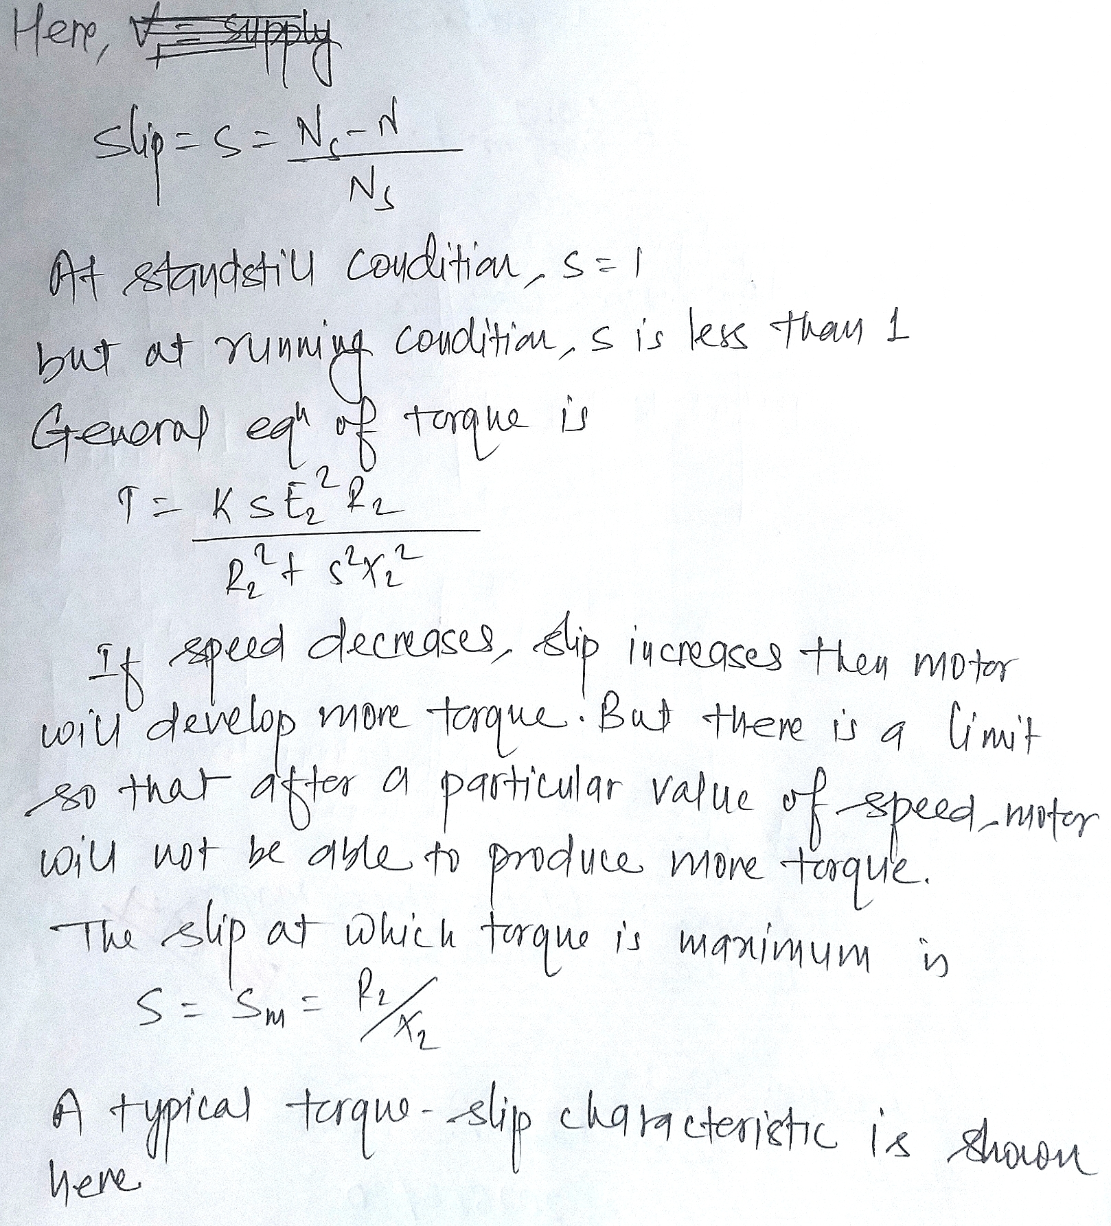

Slide 34
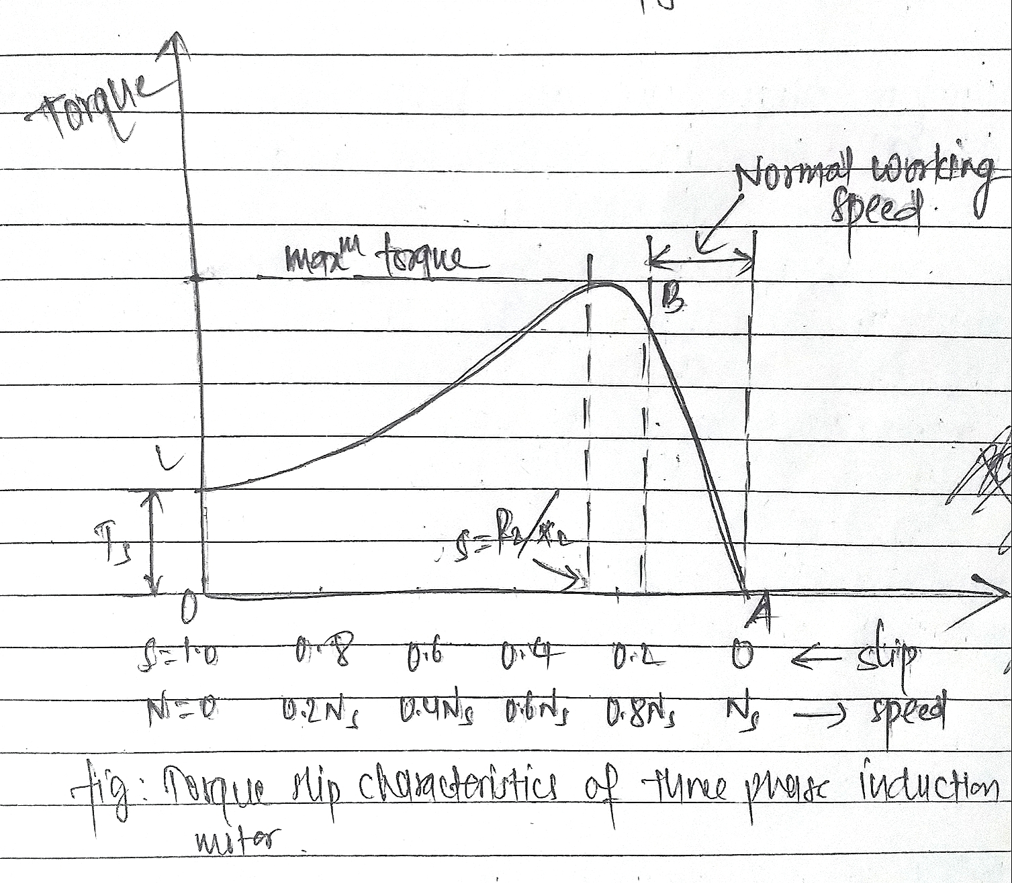

Slide 35
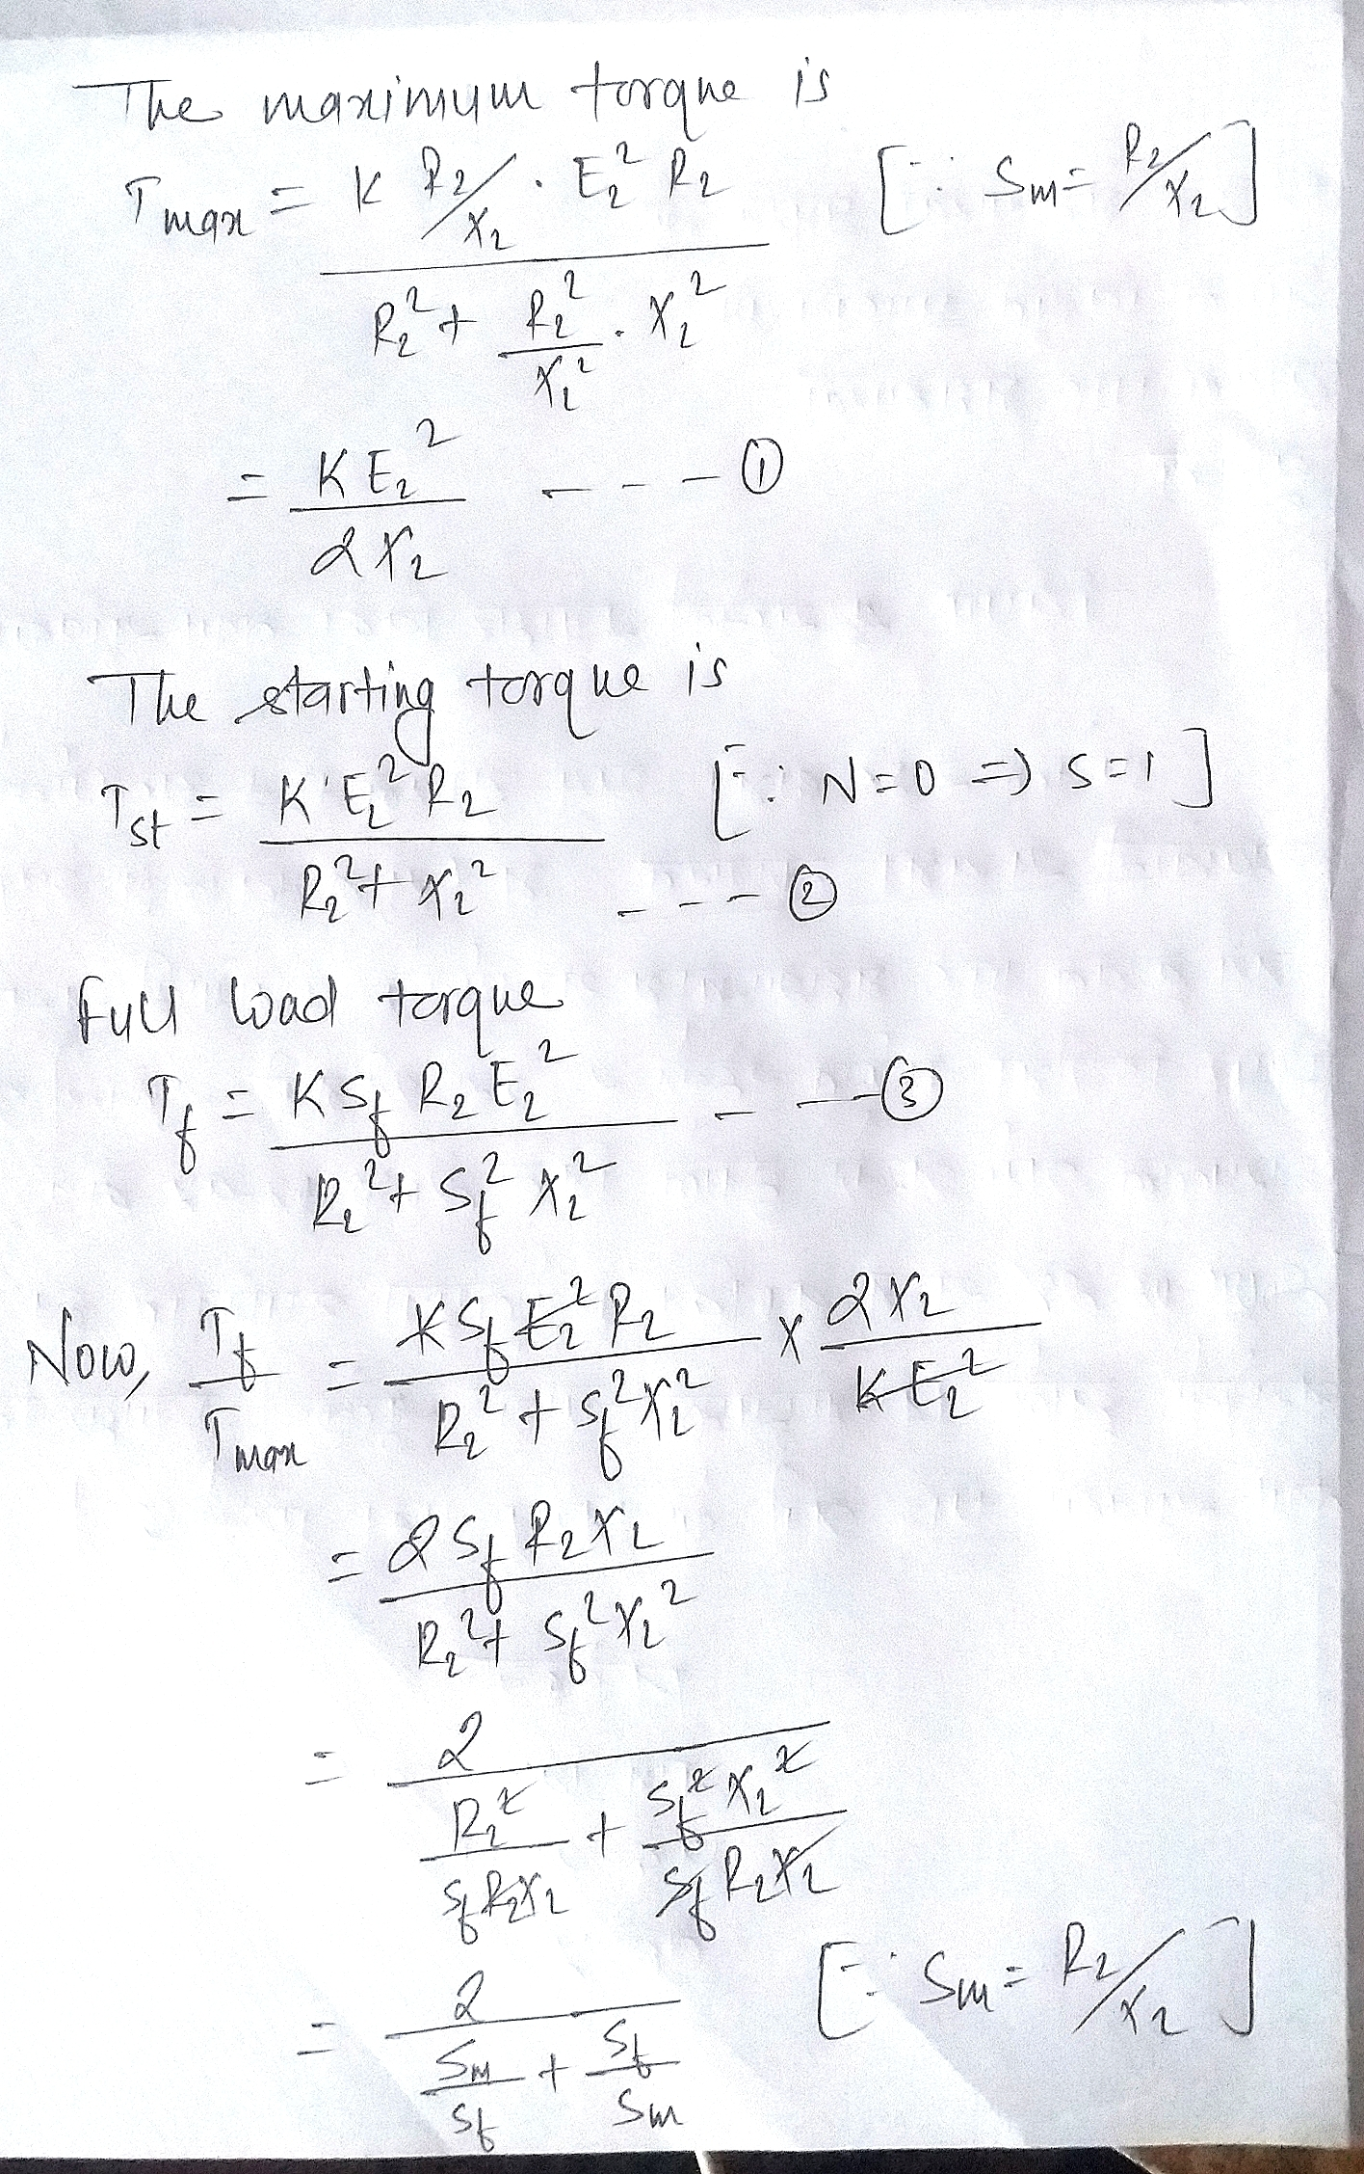

Slide 36
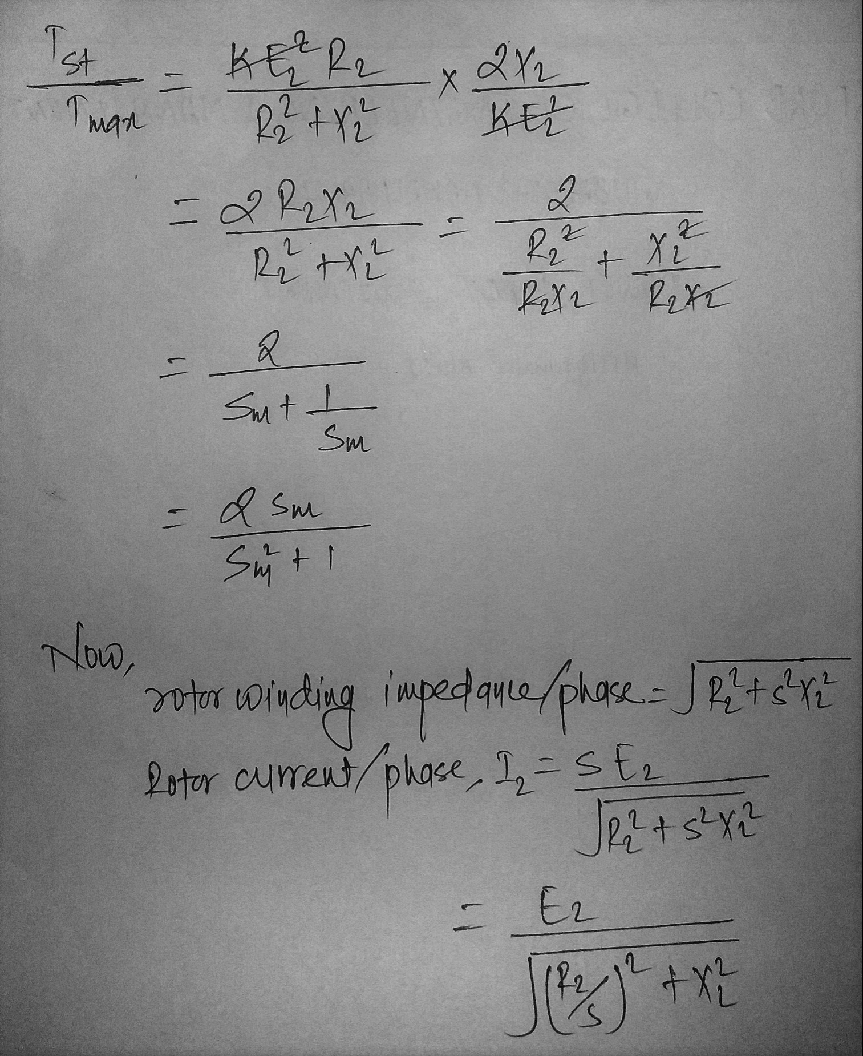

Slide 37
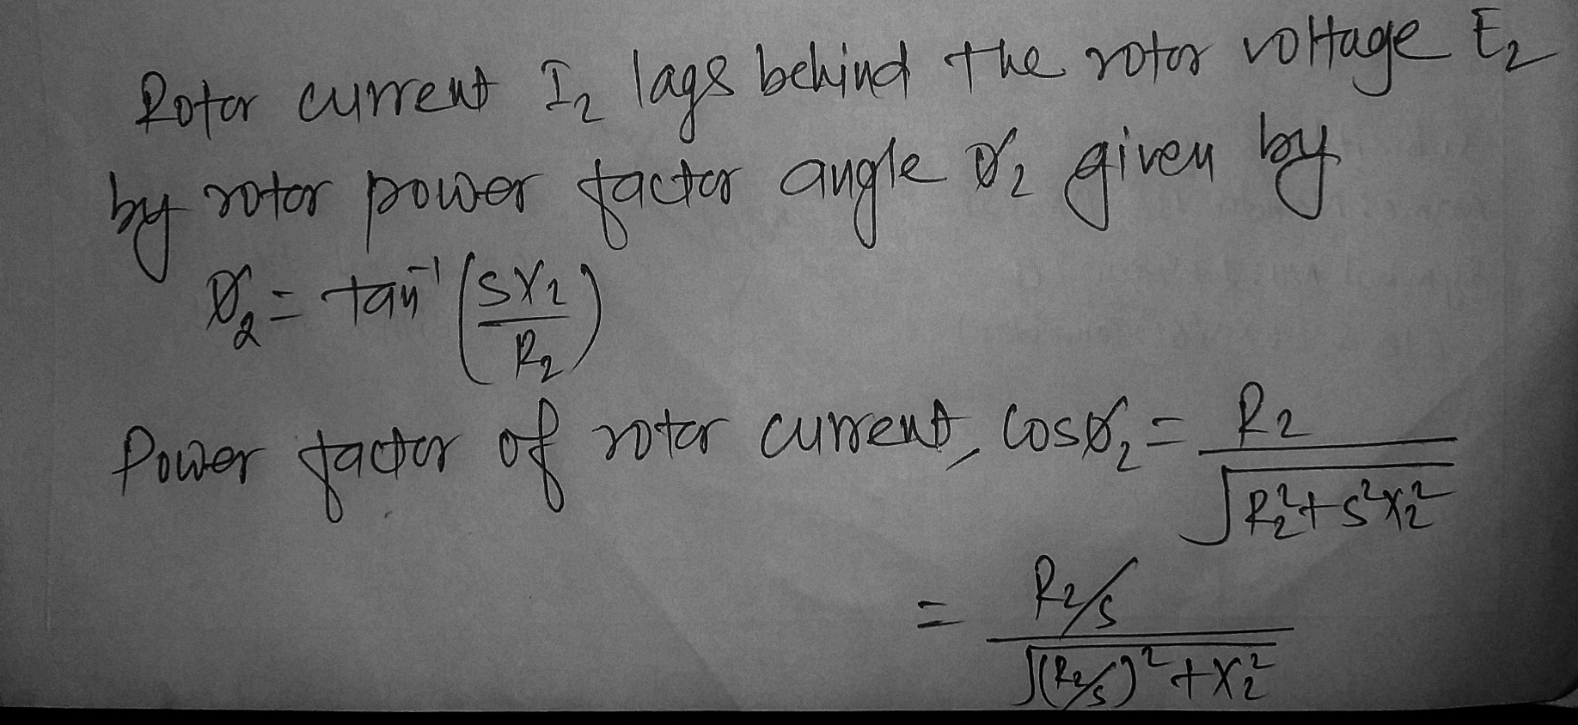

Slide 38
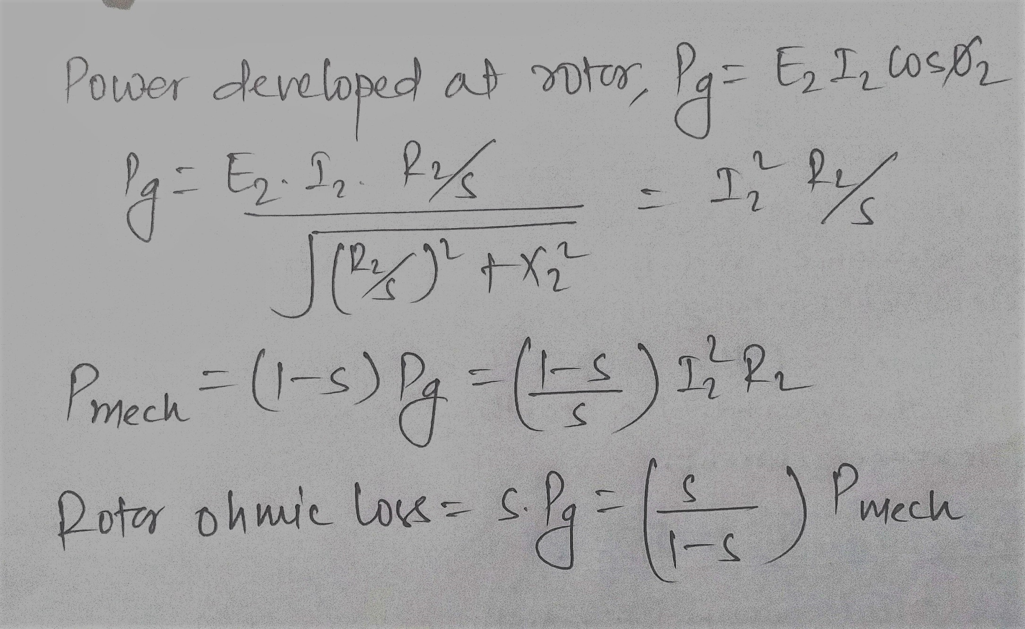

Slide 39
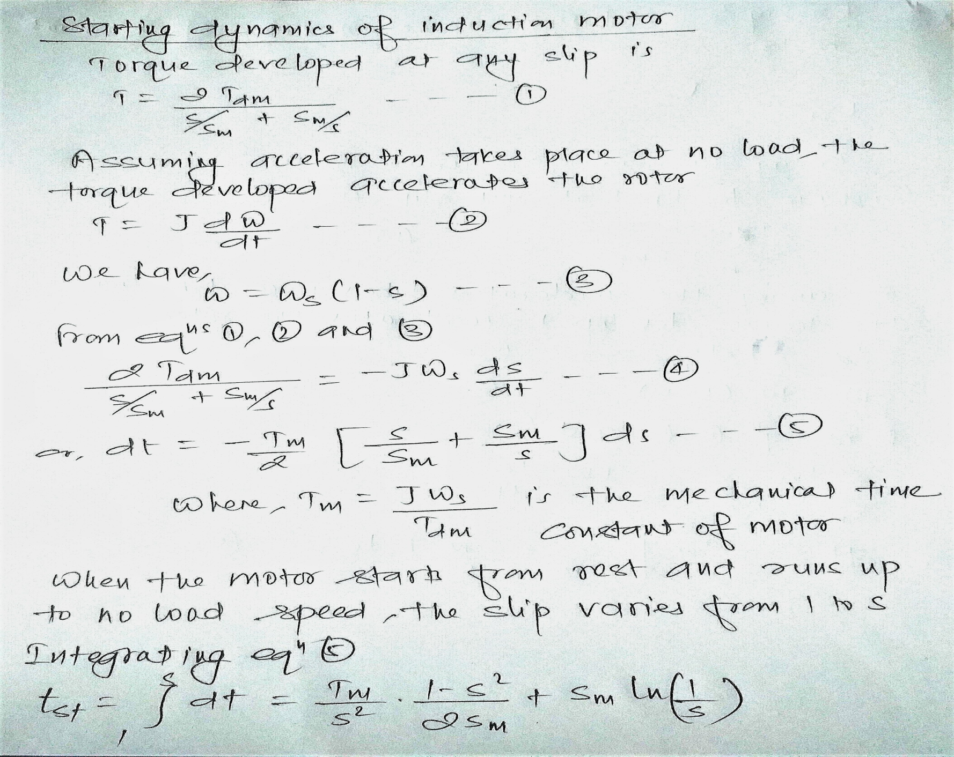

Slide 40
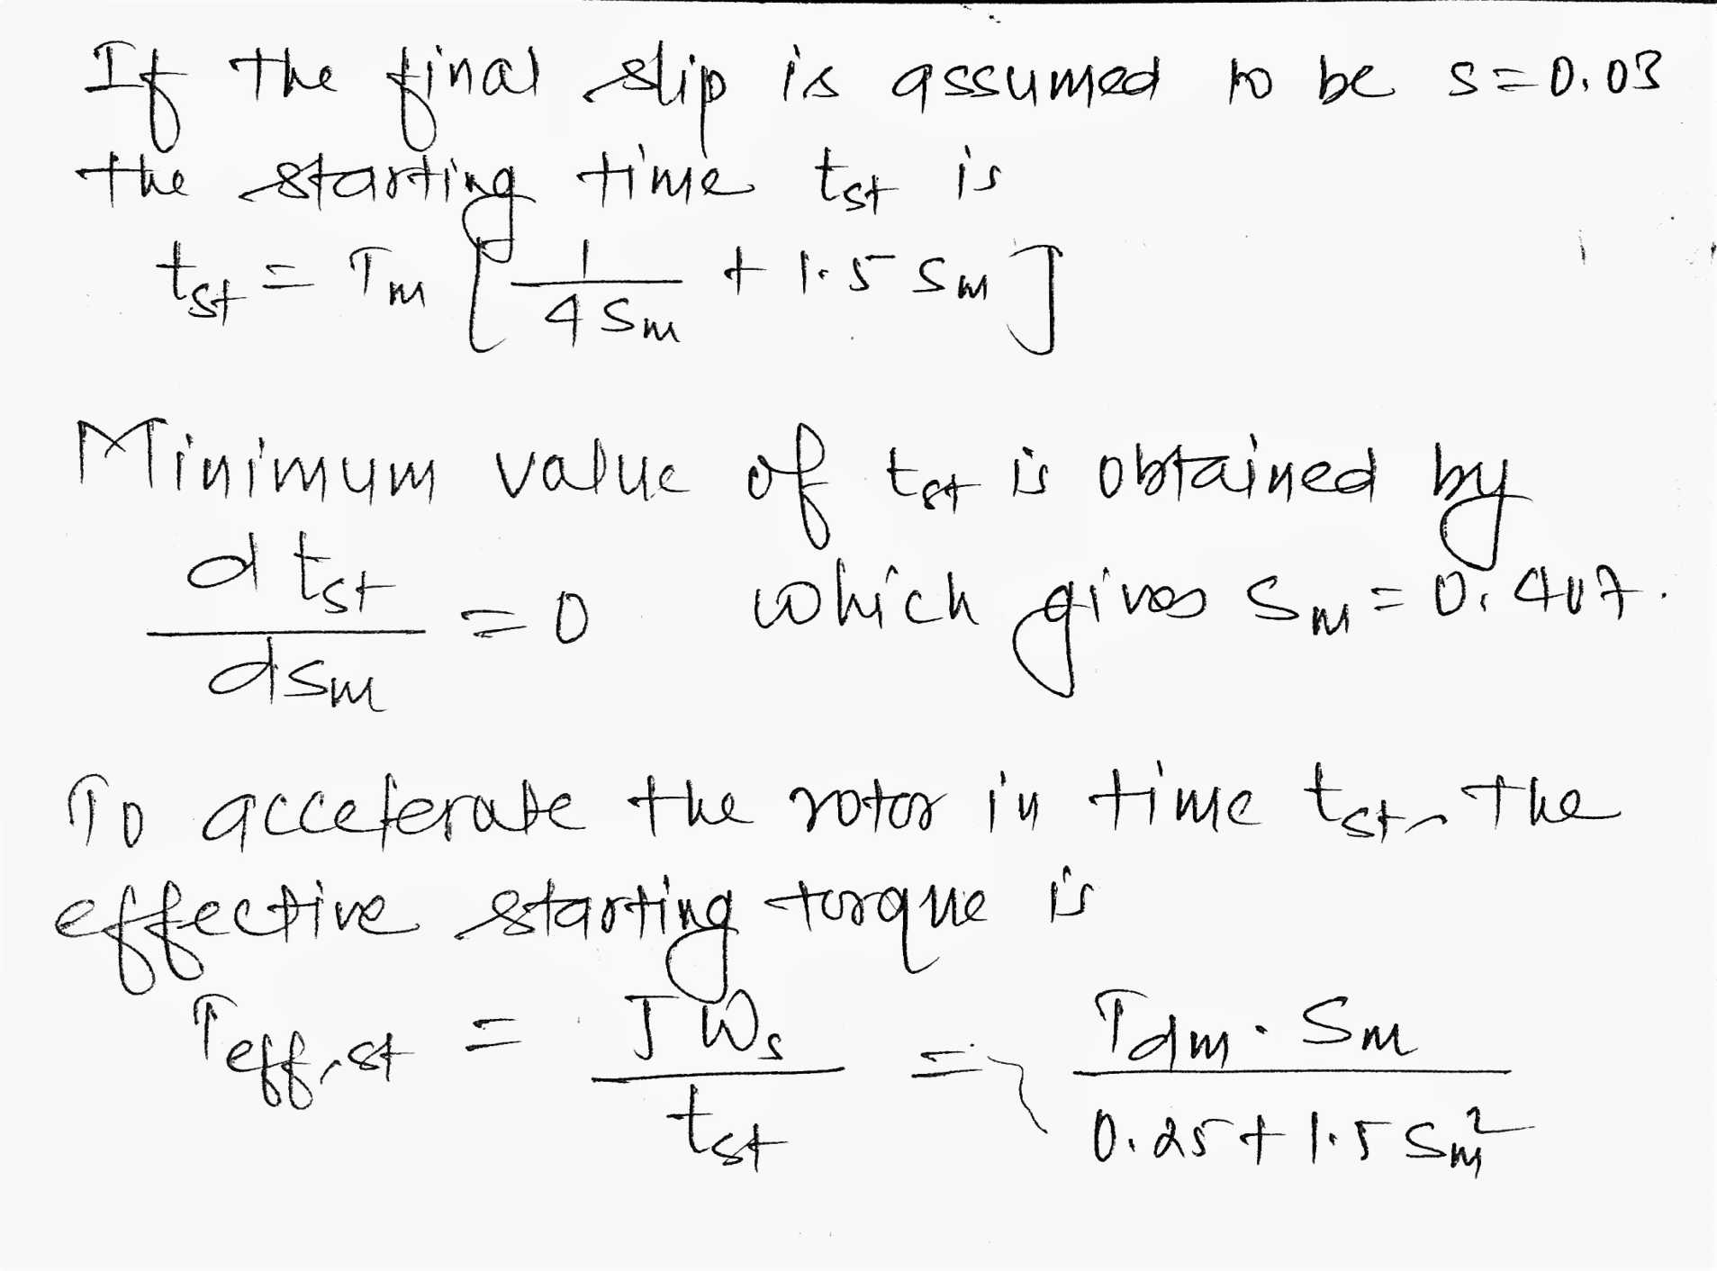

Slide 41
